Slide 1
Analytics Project Presentation - Fall 2014
Analytics Project: Will You Watch What You Read?
Team: Anto Loyola, Nikita Keswaney, Rachita Hajela
Abstract: The project attempts at finding out how well a movie will do if it has been adapted from a book of a particular genre i.e. what kind of works should movie makers adapt? Will a movie based on a romantic novel will do better than one based on science fiction novel? Or movies based on series of books like Lord of the rings are the best way to top the blockbuster charts? The project also aims at finding the anomalies where the book did exceptionally well but the movie did not and vice versa based on the IMDB ratings for the movies and GoodReads rating for the books.

Slide 2
Will You Watch What You Read?
Background
This project takes into account how well or not well the movies did which were not original ideas but were an adaptation of a novel/play/book. We are trying to find out if there is a particular genre that might be the formula for the instant hit.
Motivation
Watching movies and reading books are the favorite pass times of the today’s world. What happens when both of these are combined ? There must be a reason why movies adapted from novels are doing exceptionally well. Five of the top ten films on the American Film Institute’s list of the 100 best movies of the last 100 years are adaptations of novels. Indeed we like to watch what we read but this is not true always. There have been many instances where the bubble of hype has been severely burst by the fans of the book and the movie has been criticized a lot.
This analytic aims to find out if a movie will do better if it has been adapted from a book of a particular genre by analyzing the past trends. So that the risk of the movie makers is lowered and they know what kind of works should be adapted. This project also finds the anomaly in the data so as to help movie makers understand what went wrong.

Slide 3
Will You Watch What You Read?
Data Sources
1. Books
This data source provides us with book name and its genre along with some other information
2. Adaptation
'Adaptation' is a general data source that provides us with any work that was adapted from another work (usually, but not necessarily, in a different artistic medium). Most of the works are adapted from the books and made into films.
3. Adapted Works
This data source provides us with works that have been adapted into various forms, or 1 work that has been adapted many times for example William shakespear’s taming of the shrew has been adapted into 5 different movies.

Slide 4
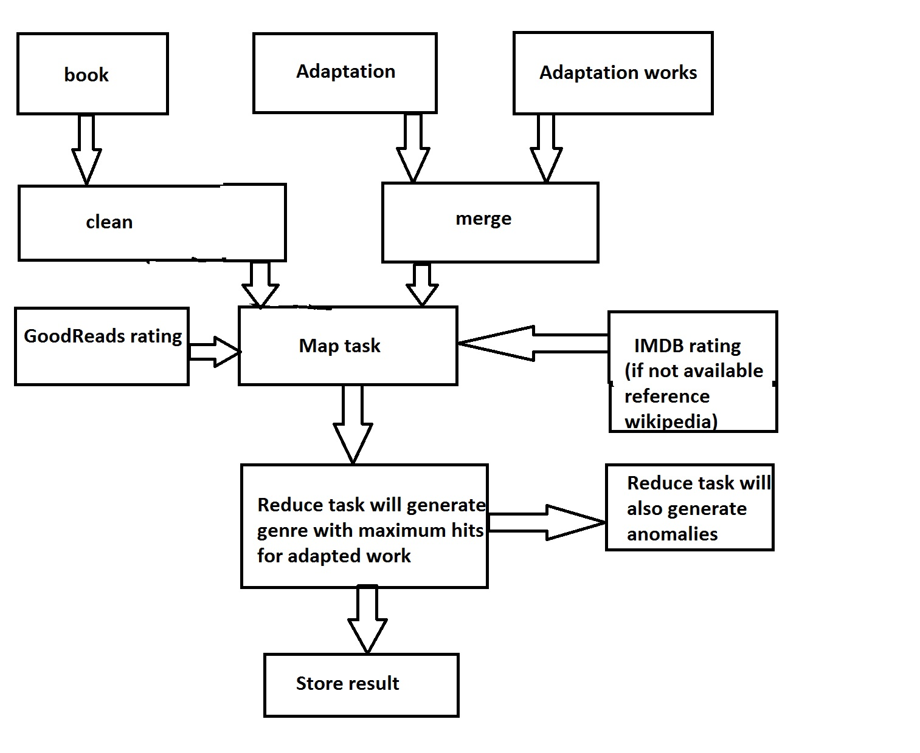
Will You Watch What You Read?
Design Diagram

Slide 5
<Your project name>
Results
<
Tell us about your results.
Tell us why you believe that your analytic worked, or didn’t work.
>

Slide 6
<Your project name>
Obstacles
<If you encountered any obstacles, tell us about them.>

Slide 7
Will You Watch What You Read?
Conclusion
<Short wrap-up!>
Acknowledgements
We would like to thank our Professor Suzanne McIntosh for her immense support in developing the project and helping us out with the various technologies that could be used in the project.

Slide 8
Will You Watch What You Read?
References
Chan Ik (Park Chungwoon University ), Ho Eun ( Lee Chungwoon University), An Investigation into the Factors Determining the Success of Comic Book-Based Movies, http://www.aicit.org/AISS/ppl/AISS3692PPL.pdf
Ashley Ross, How to turn a book into a movie that isn’t terrible, http://time.com/2815729/book-to-movie-adaptations-screenwriters
Dwight C. Douglas How to adapt a novel into a screenplay, http://www.videomaker.com/article/15701-how-to-adapt-a-novel-into-a-screenplay
Michael Hauge, ADAPTATION: Mvies arem’t novels, http://www.storymastery.com/articles-by-industry/articles-for-screenwriters/movies-arent-novels/
Lynne Pembroke and Jim Kalergis, From Novel to Screenplay: The Challenges of Adaptation, http://www.writing-world.com/screen/adaptation.shtml
Adaptation from novel to film, http://d2buyft38glmwk.cloudfront.net/media/cms_page_media/11/FITC_Adaptation_1.pdf

Slide 9
Will You Watch What You Read?
Thank you!

